Slide 1
Bedtime smartphone usage and its effects on sleep and productivity at work place
By
Rajdeep Chakravorty
Kartik Meher
Ashish Kumar

Slide 2
Introduction

Slide 3
The technological revolution has made smartphones to be exceptionally appealing and well-known.
They have become an important piece of daily life, being progressively utilised among the kids and adults.
The smartphones are one of the most widely recognised methods for corresponding and communicating; therefore, they are becoming a necessity in the humans' lives.
For most populations, a smartphone is a primary thing human will use when awake in the morning and before they sleep. However, the excessive usage of mobile phones has been associated with many health problems, including both biological and psychological issues.

Slide 4
Literature review
- Bedtime Smartphone Usage and Sleep Quality
The increasing frequency and time spent on the smartphone lead to smartphone addiction .Smartphone addiction is a non-chemical behavioural addiction that involves human-machine interactions, also known as technological addictions Recent studies show that smartphone addiction is related to sleep disturbance and depression . The addiction leads to sleep interference as the smartphones are placed within reach even when sleeping at night

Slide 5
Work Performance
There is sufficient evidence that individuals with better sleeping quality conduct fewer workplace errors due to better alertness and concentration thus, sleep quality is important for being productive at work.
Our research points out that the increasing use of smartphone may bring unwanted consequences, such as smartphone addiction symptoms. This can be harmful to the employees, as well as organisations because the concentration and productivity at work are reduced. In support, our studies indicates .

Slide 6
RESEARCH METHODOLOGY
STATEMENT OF THE PROBLEM
The focus of this report is conducting a study and inferring whether sleep and mobile usage at bedtime has a negative impact on the work efficiency of the employee.

Slide 7
Data collection method : Primary data
An online survey was conducted among the employees working in IT sector to test the hypotheses used in this study statistically
Instrument Development
A survey questionnaire was used as an instrument for data collection. The questionnaire was designed using Google form; then the link was shared among the participants to get quick and timely response.

Slide 8
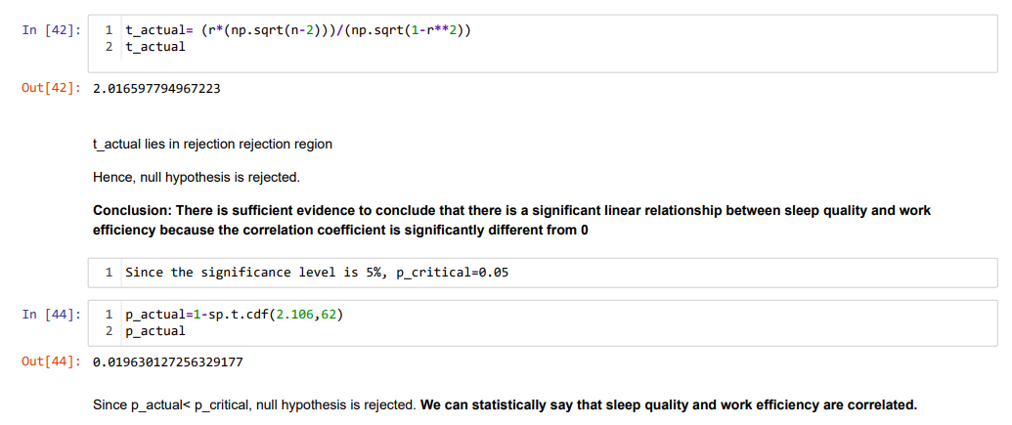
Results

Slide 9
Limitations
In the course of the study, some challenges were encountered that limited the research in one way or another and some of them are as follows so that the findings of the study are understood in proper perspective.
The limitations to the study are as follows:
Sleep can also be affected by other factors like age, health issues etc which were not considered in our study.
The respondents were limited since we were within a time constraint.
We cannot tell whether this might be their actual behaviour so there might be self-reported bias.

Slide 10
Future scope
In this study the data that was collected was limited to one sector only, in future the study could be extended to different sectors.
The number of respondents could also be extended to get better insights about data.
If someone wants to research in the future about this topic then they can also add an important factor like smart phones which can affect both sleep and work efficiency.

Slide 11
Conclusions
From our research conducted we can conclude that usage of smart phones can lead to sleeping less which ultimately has an adverse consequence on work efficiency and productivity resulting in great loss to the companies.
The employees should be extra vigilant, as this behaviour might unknowingly affect their career growth and progress since it is proven to be an inhibitor for work performances and productivity.

